Slide 1
Sowing Change (SCH)
2024-1-ES01-KA220-SCH-000245566
II. Primary school Varazdin
Croatia
Celebrated days
June, 2025.

Slide 2
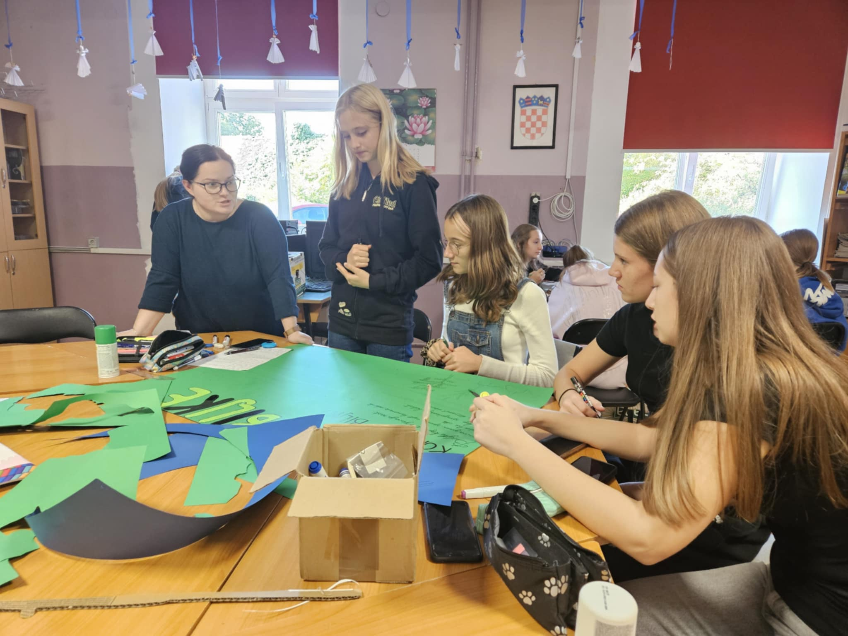
Erasmus Days 18. 10. 2024.
poster making
poster presentation to other students
organization and lecture Erasmus Days

Slide 3
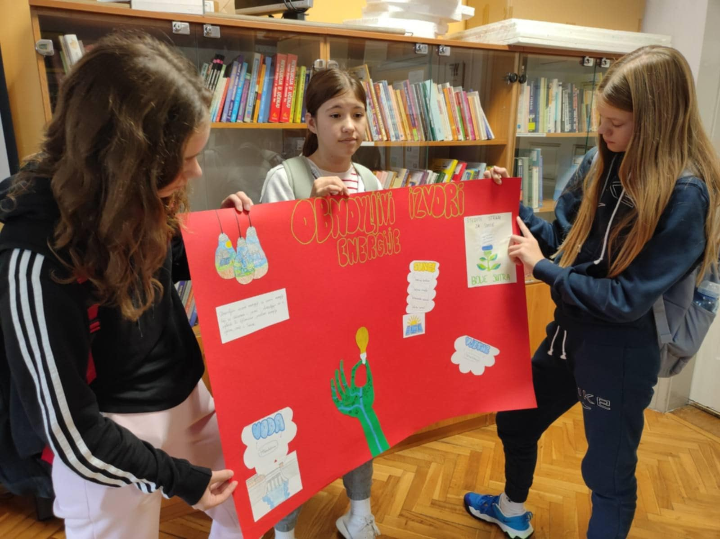
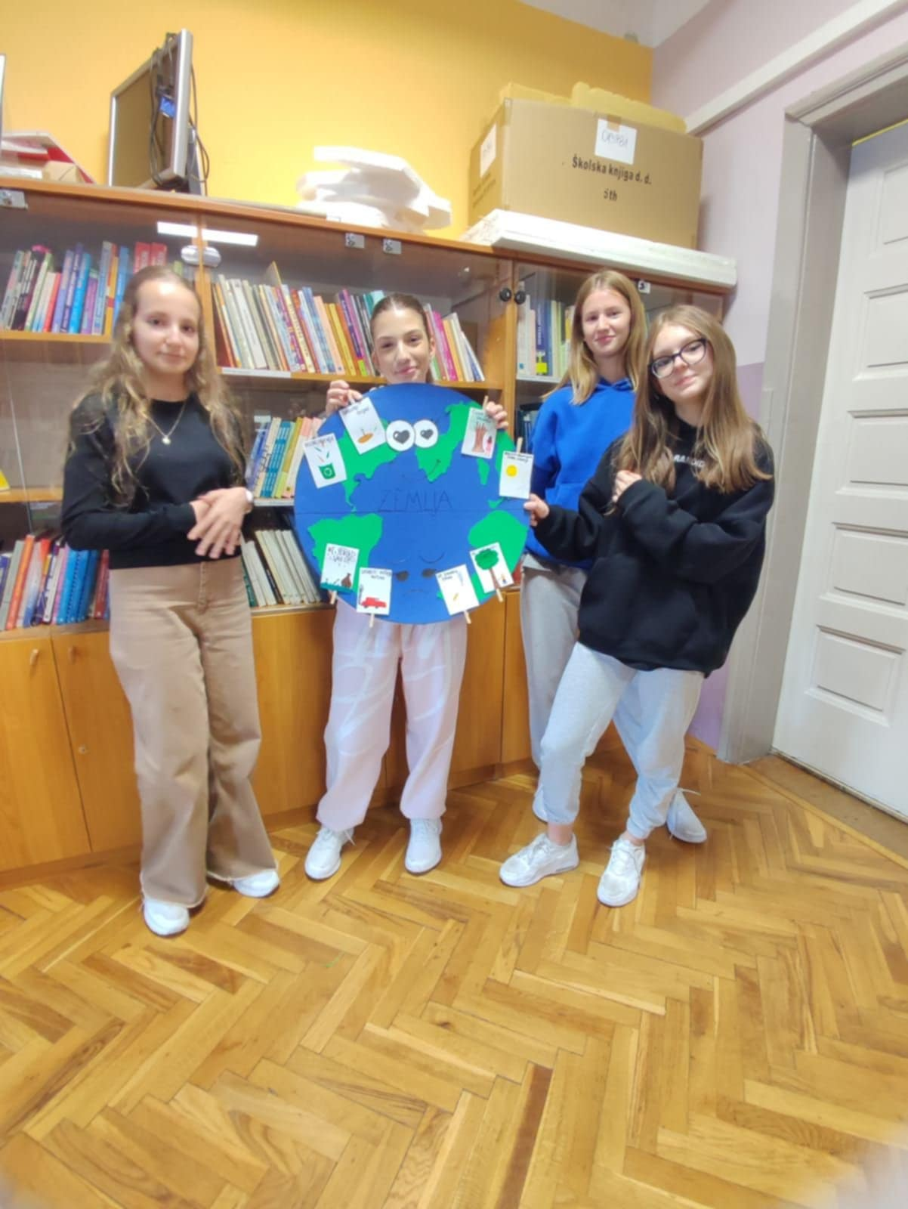
Erasmus Days 18. 10. 2024.

Slide 4
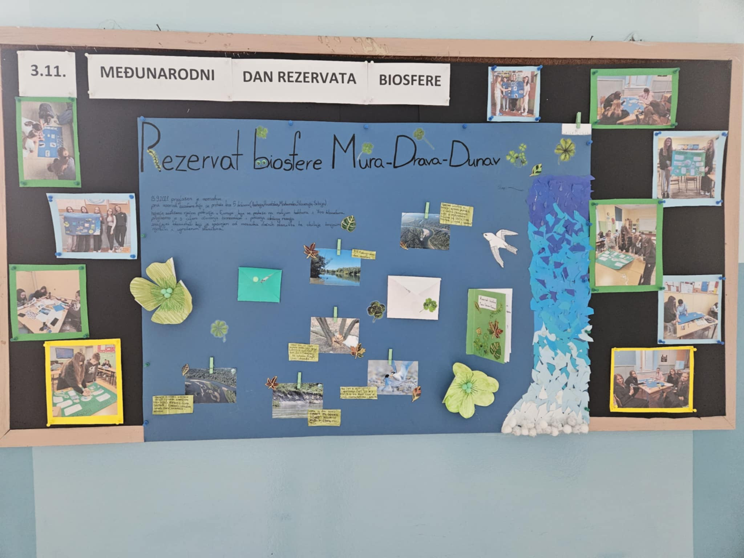
International Biosphere Reserve Day 3. 11. 2024.
poster making
poster presentation to other students

Slide 5
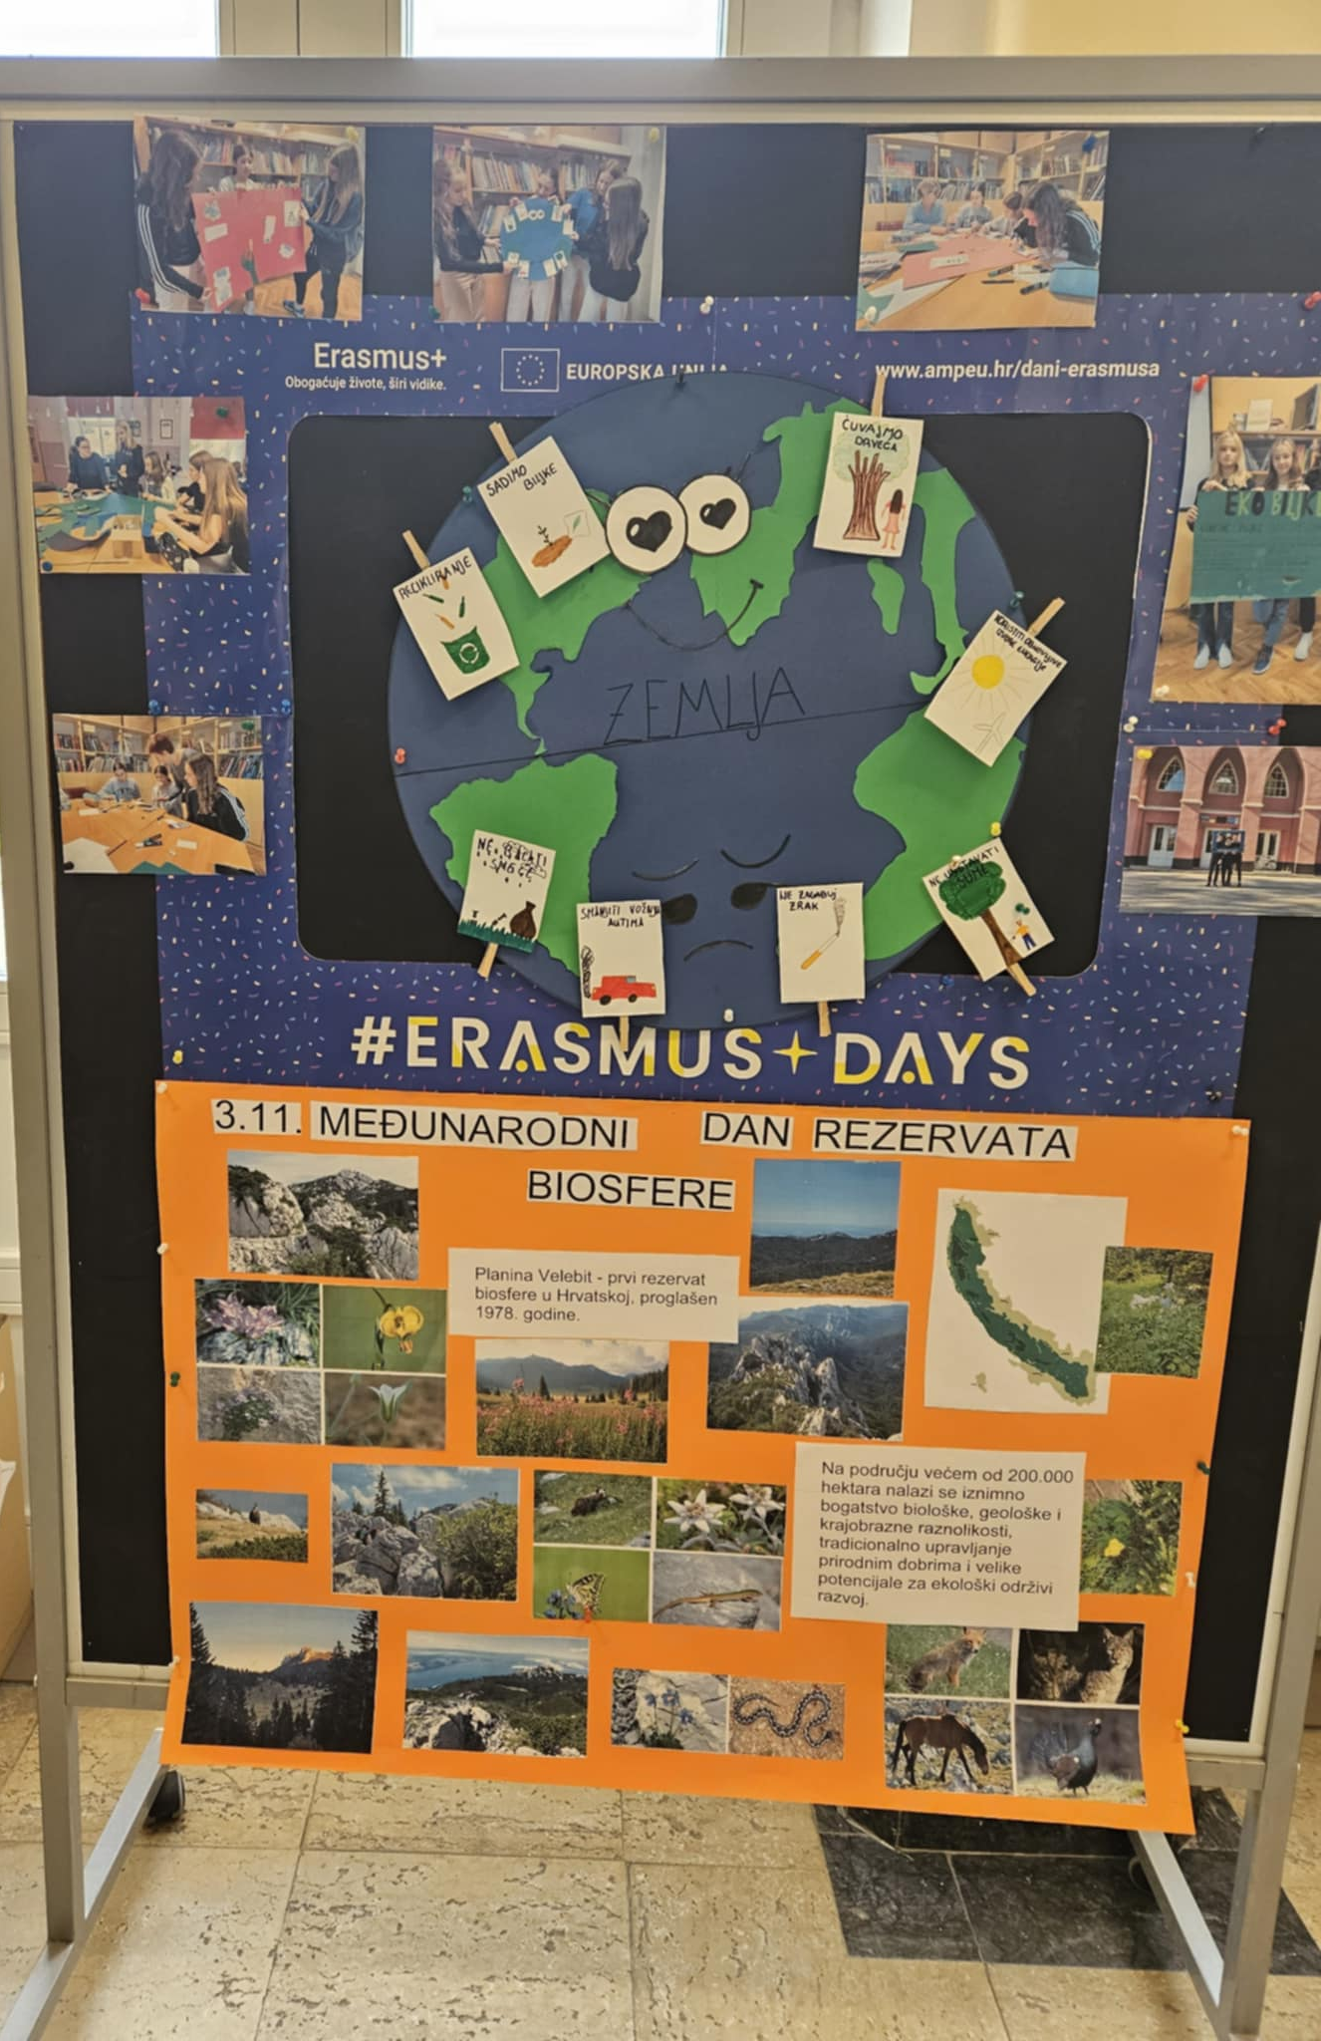
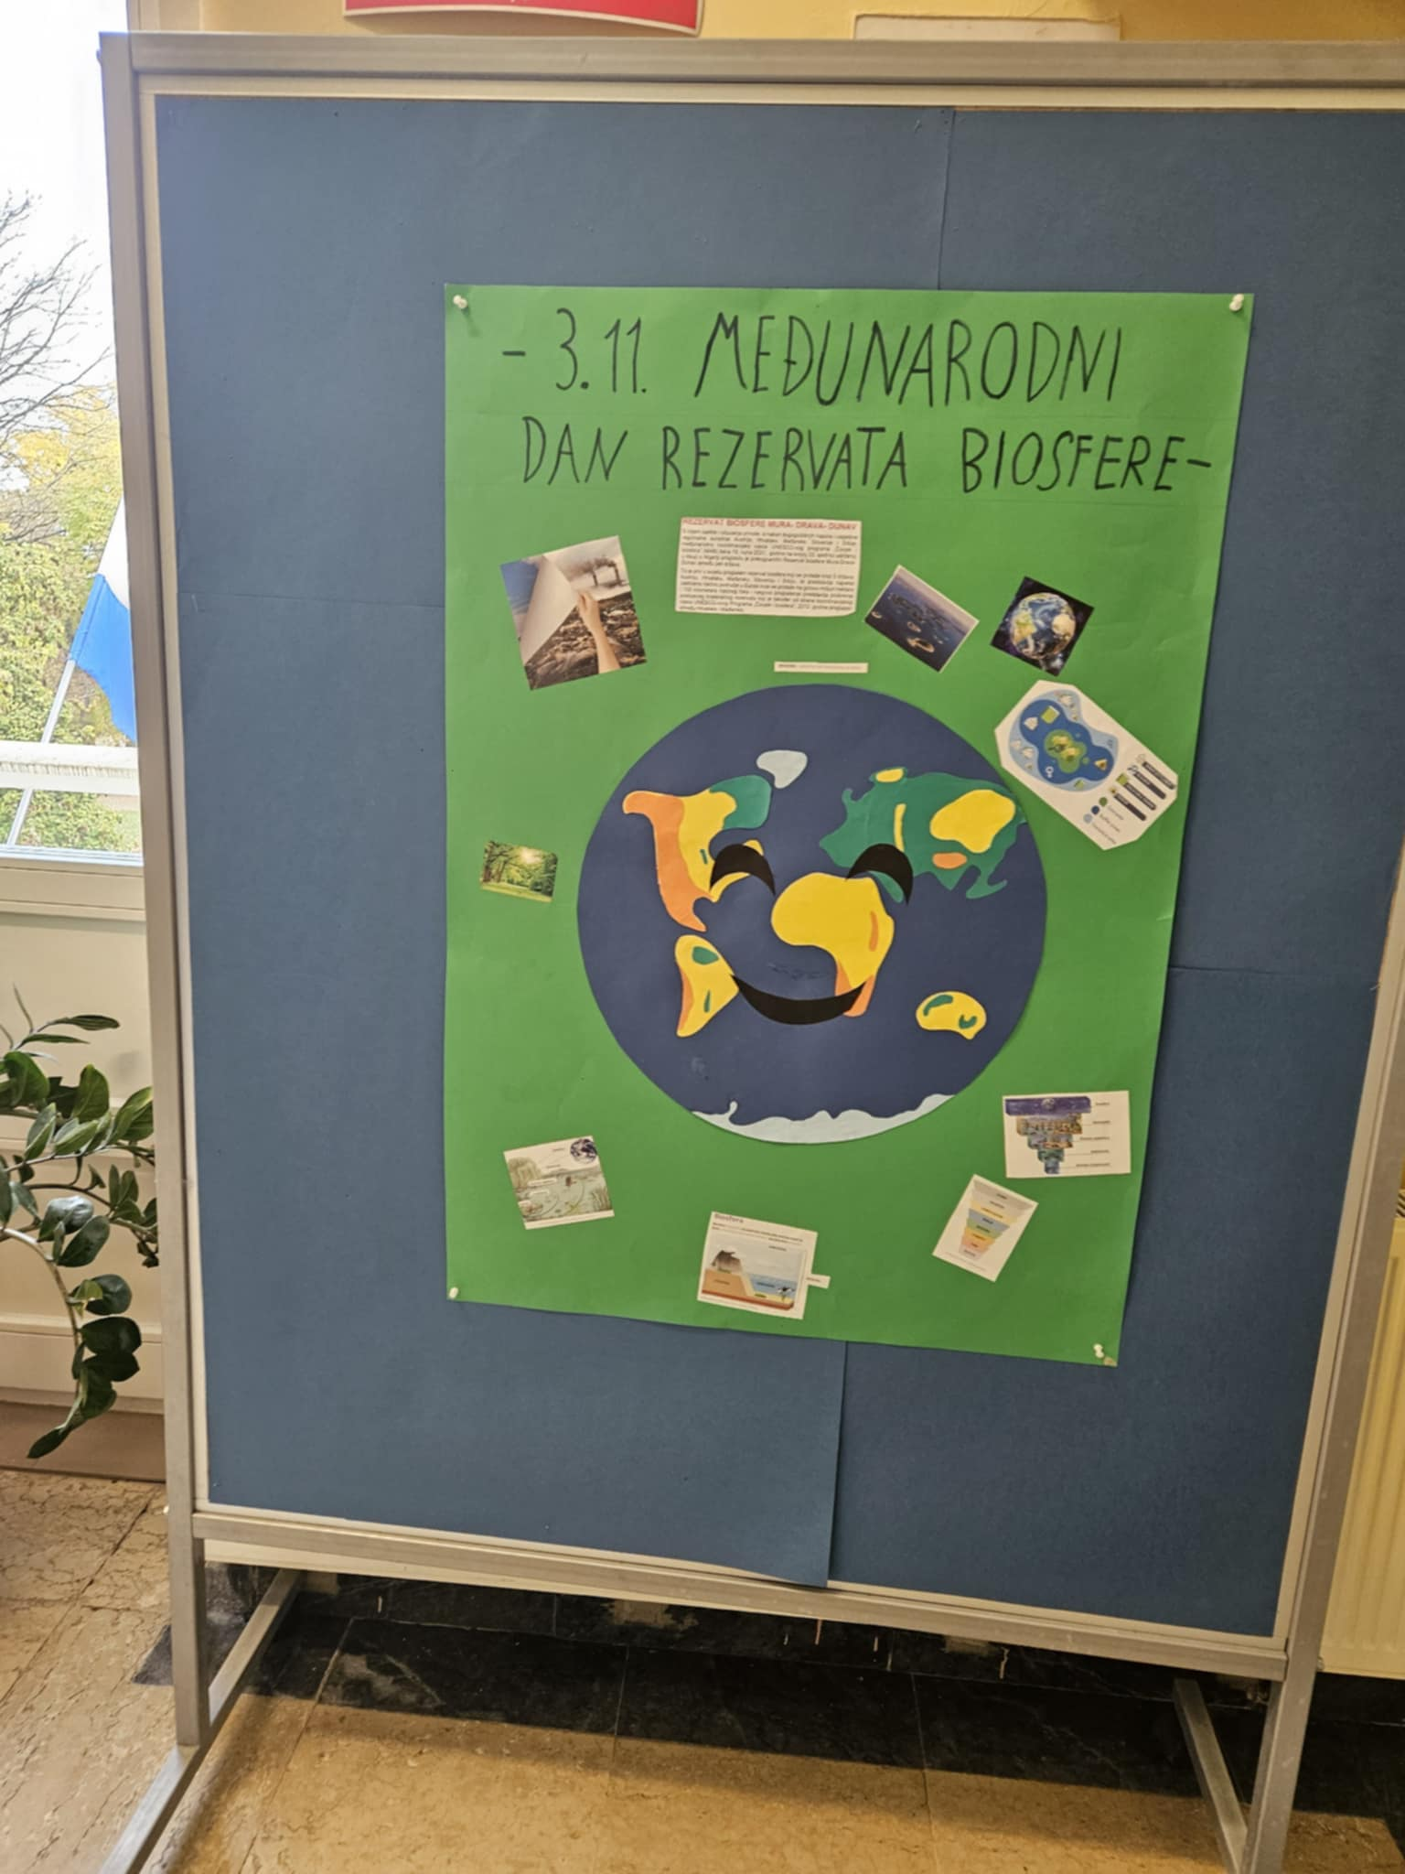
International Biosphere Reserve Day 3. 11. 2024.

Slide 6
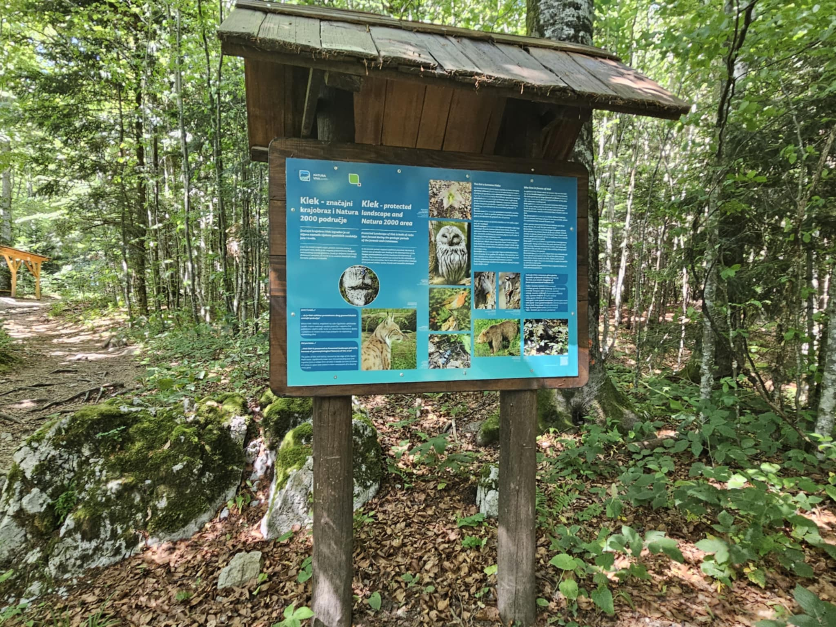
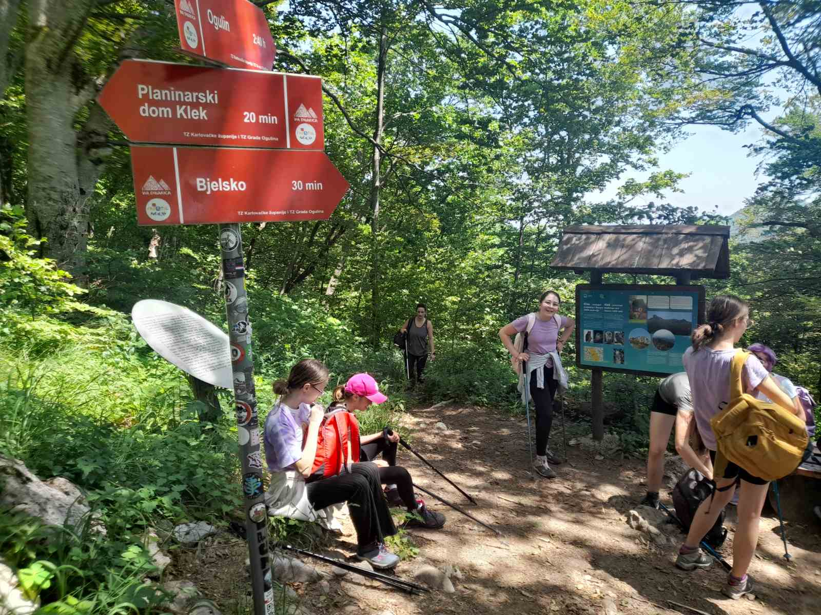
International Day of Forests 21.3.2025.
we marked it with a hiking trip to Klek
the Klek area is protected as a significant landscape due to its exceptional landscape and biological value,
part of it is protected as a geomorphological and botanical reserve.

Slide 7
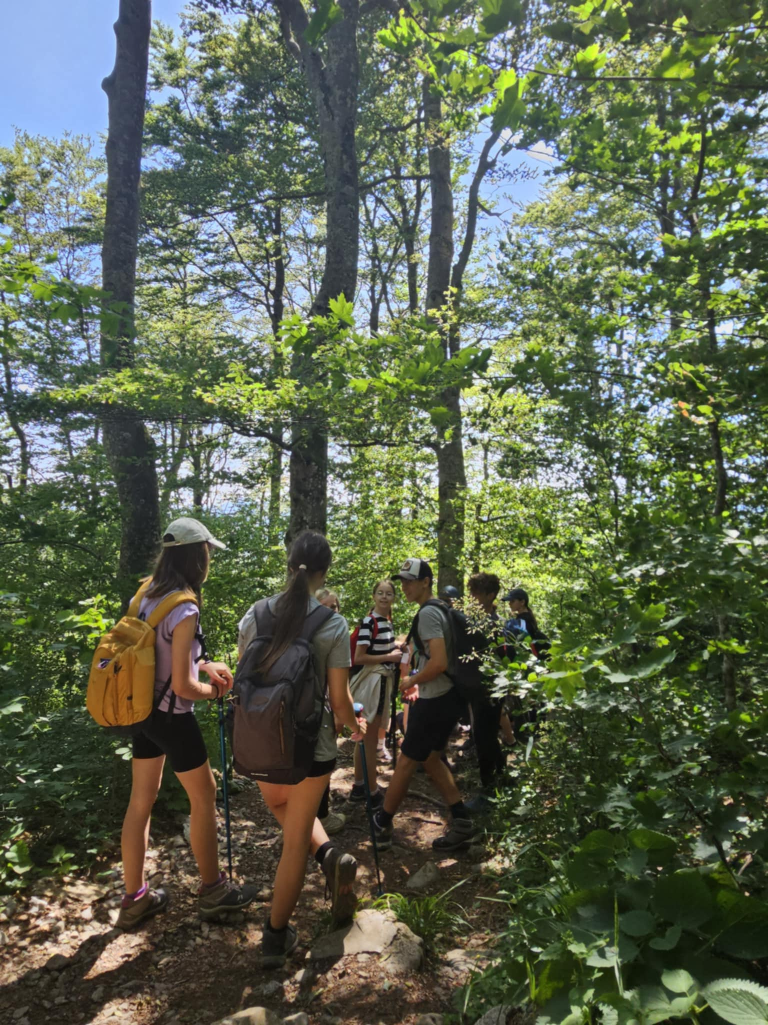
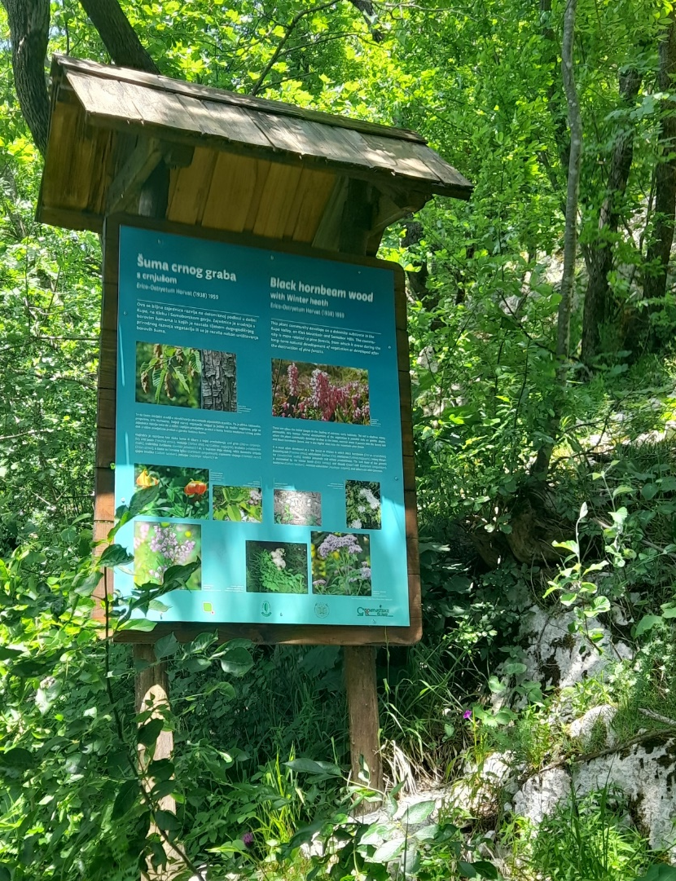
International Day of Forests 21.3.2025.

Slide 8
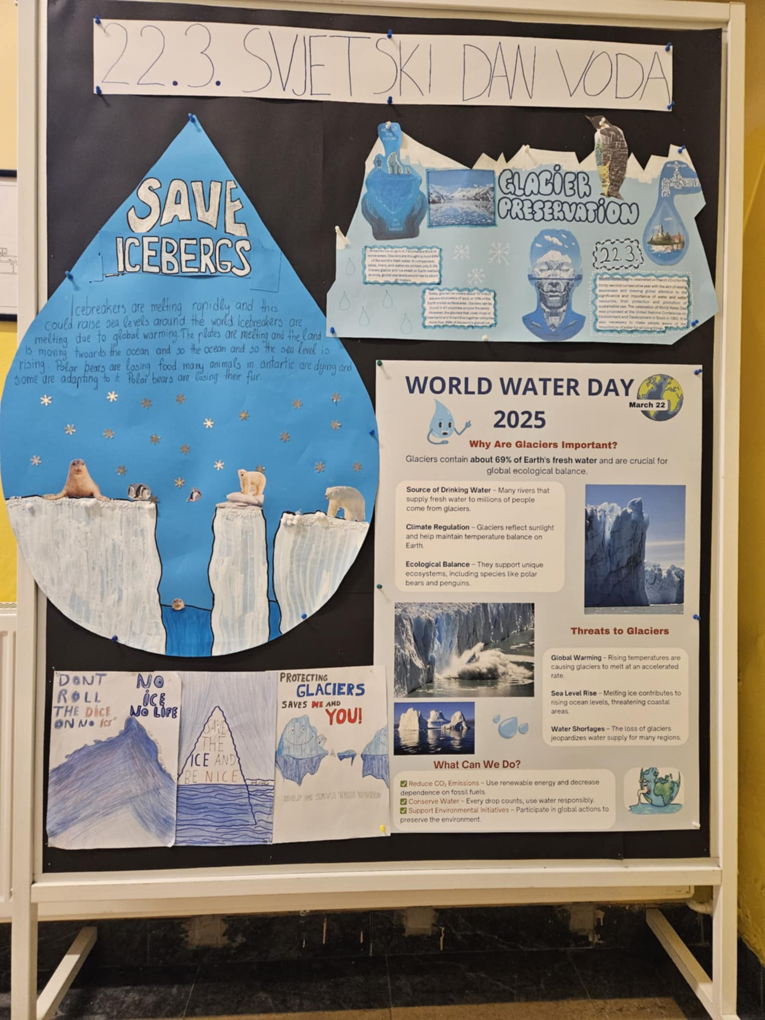
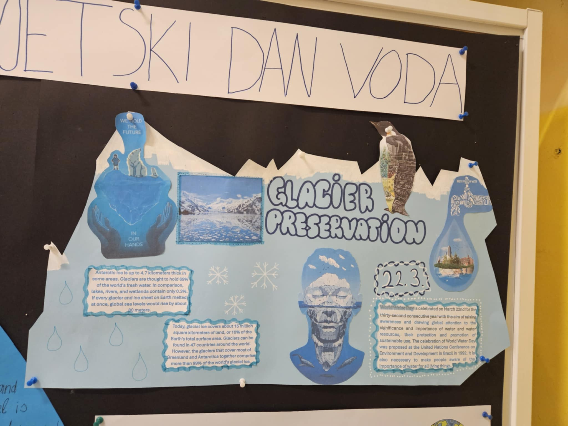
World Water Day 22. 3. 2025.
poster making
poster presentation to other students
with special emphasis on glacier protection

Slide 9
World Water Day 22. 3. 2025.

Slide 10
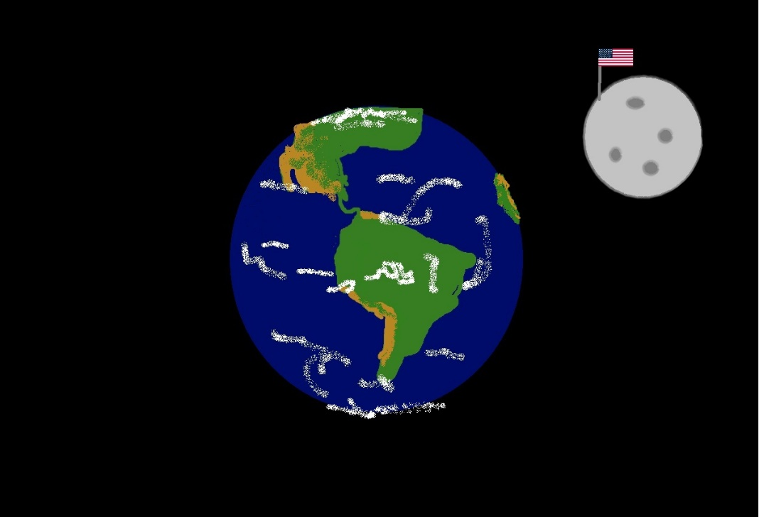
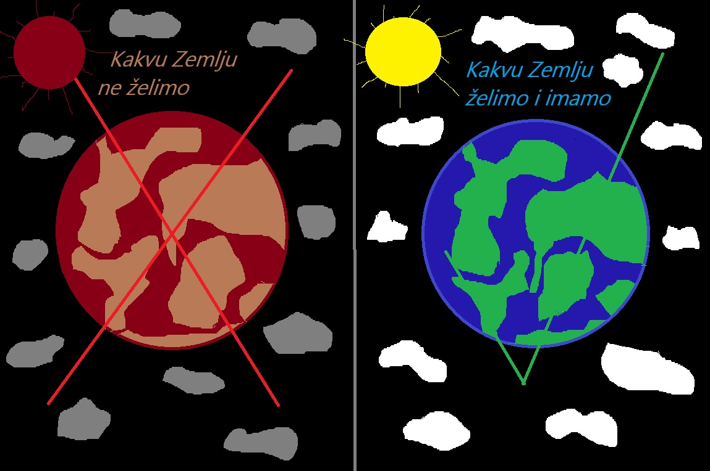
Earth Day 22. 4. 2025.
students used the Colors program to draw whatever planet they wanted

Slide 11
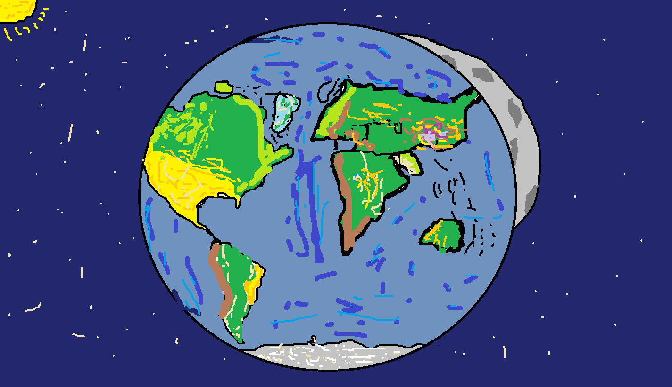
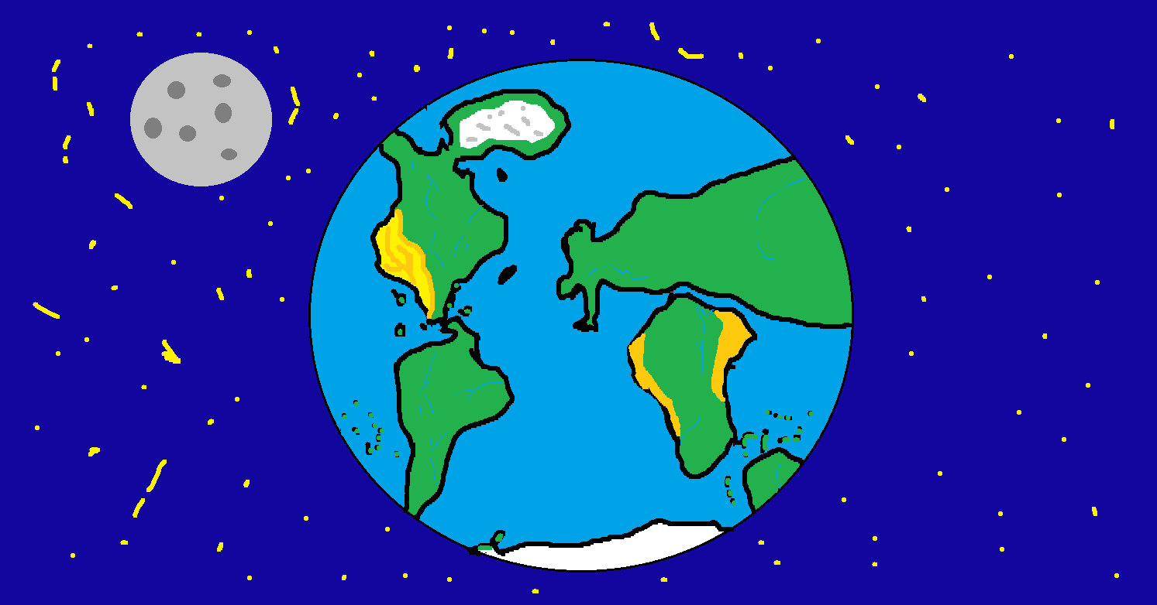
Earth Day 22. 4. 2025.

Slide 12
World Environment Day 5. 6. 2025.
with a special emphasis on reducing plastic waste

Slide 13
World Environment Day 5. 6. 2025.

