Slide 1
European MakerSpace Network
Erasmus+ 2020-2023
2020-1-ES01-KA229-082563
II. Primary school Varazdin
Croatia
Dissemination

Slide 2
school teachers
introducing other teachers in the school with the project

Slide 3
posters at school

Slide 4
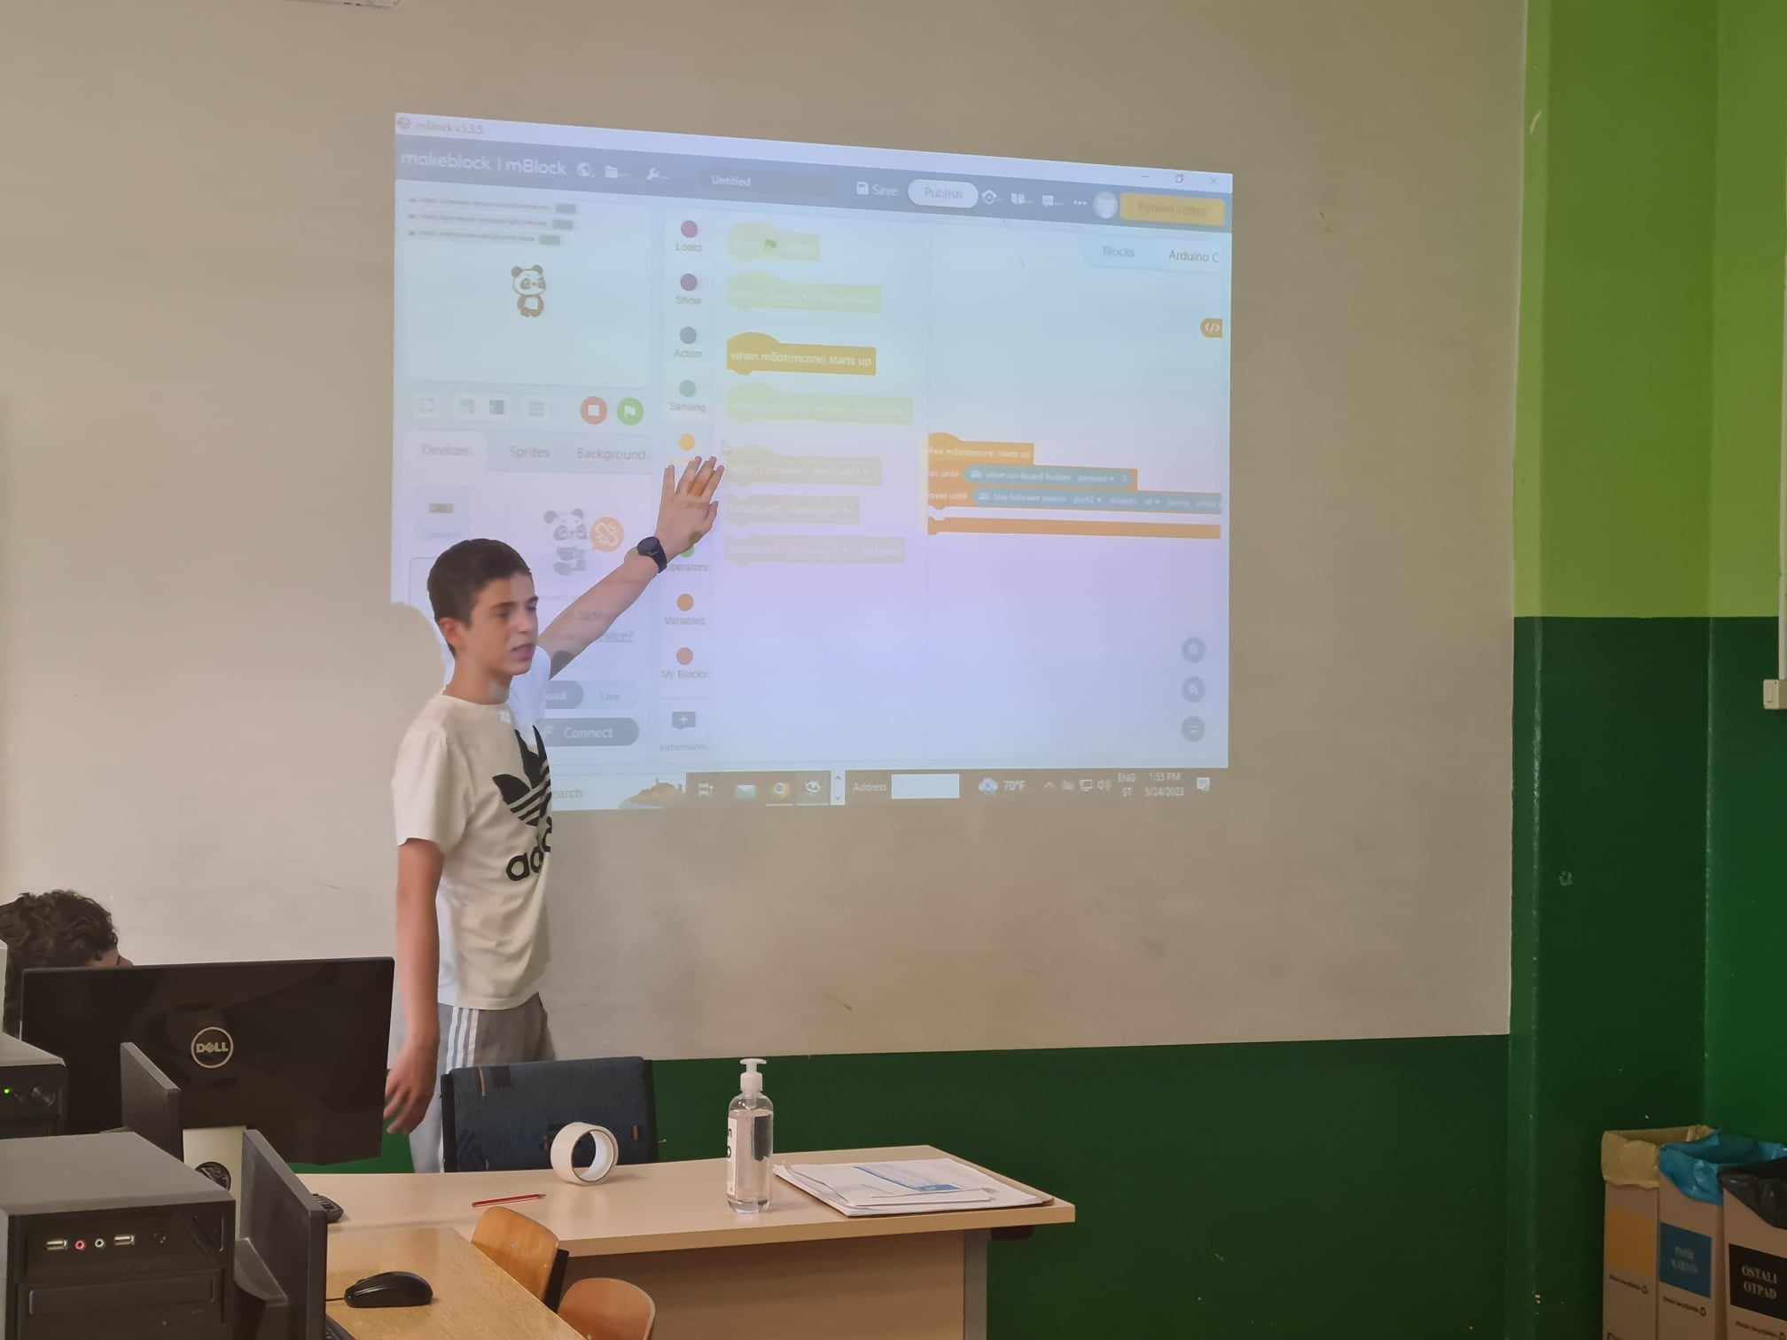
students
introducing other students in the school with the project
European MakerSpace
Network

Slide 5
Newspapers in print and digital form
Link to news
Link to news – Zvonilica 2021.
Web site
Facebook

Slide 6
Introducing the project to other computer science teachers of the Varaždin County
European MakerSpace Network

