Slide 1
Human Rights Education
2020-1-SK01-KA229-078211
II. Primary school Varazdin
Croatia
Dissemination

Slide 2
School teachers
introducing other teachers in the school with the project

Slide 3
Posters at school

Slide 4
Students
introducing other students in the school with the project

Slide 5
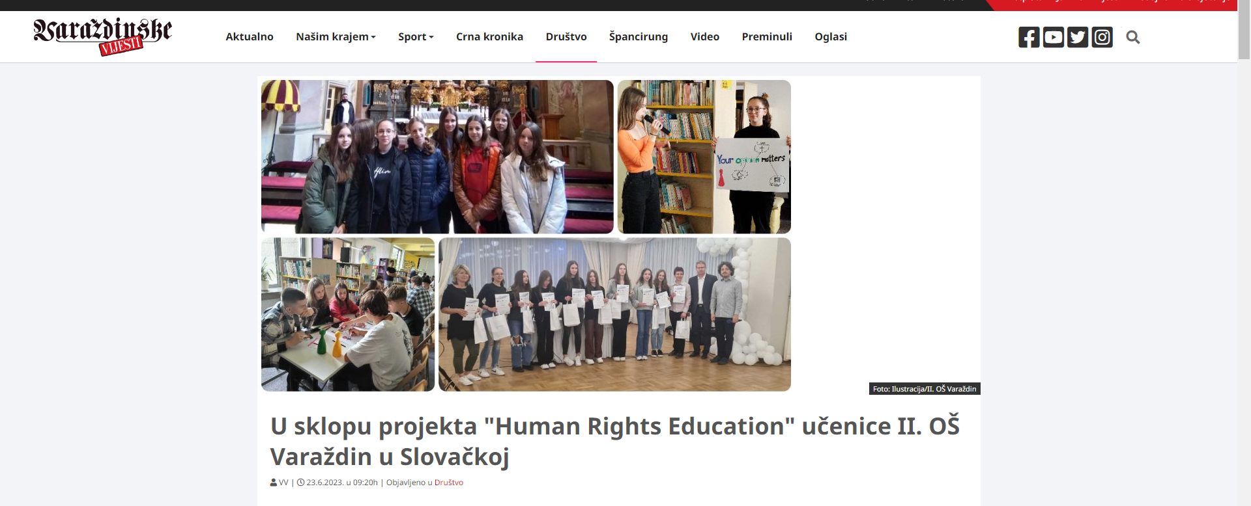
Newspapers in print and digital form
Link to news - Spain
Link to news – Varazdin
Link to news – Slovakia
Link to news – International Day for the Elimination of Racial Discrimination
Project fair – Zagreb, May 2023.
Link to news – Zvonilica 2021.
Link to fair – Sajam uključivanja i razolikosti
Web site
Facebook

Slide 6
Introducing the project to other computer science teachers of the Varaždin County
Human Rights Education

