Slide 1
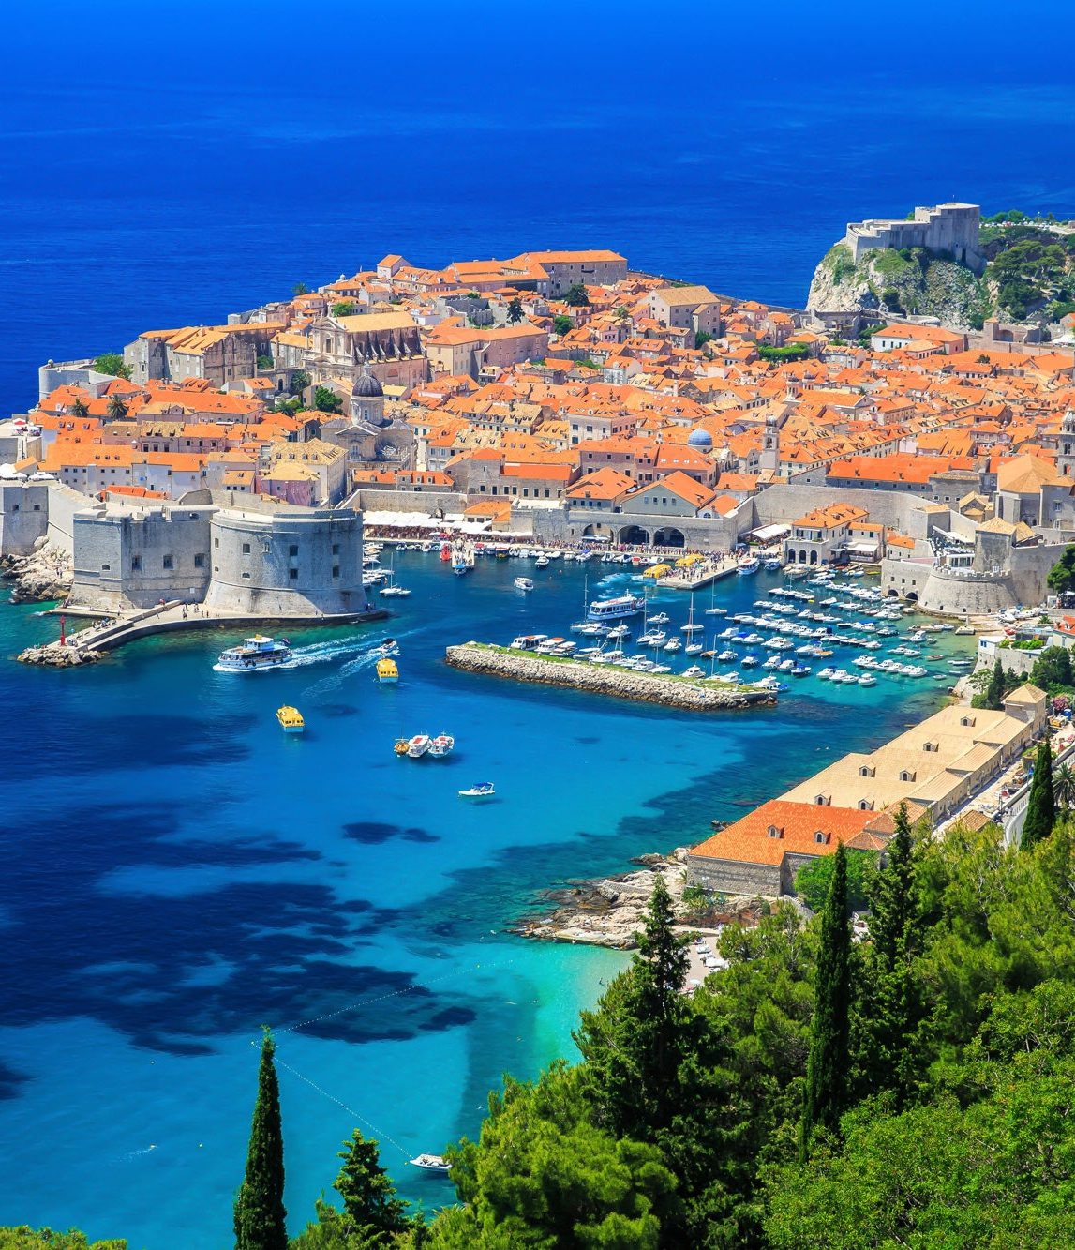
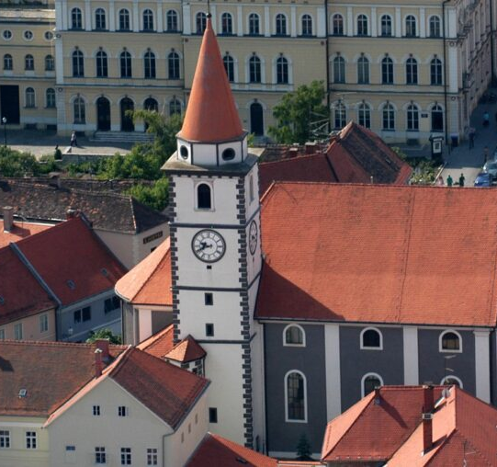
CROATIA
Made by:Jurica Geček, Karla Plantak

Slide 2
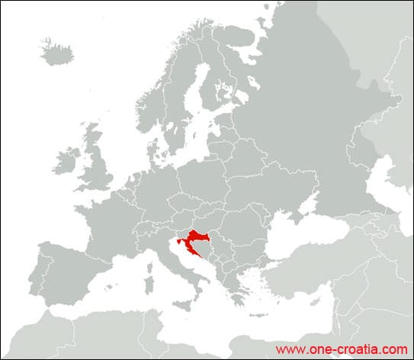
CROATIA
Croatia is a country placed in Europe
It has beautiful sea called the Adriatic Sea
the capital city is Zagreb

Slide 3
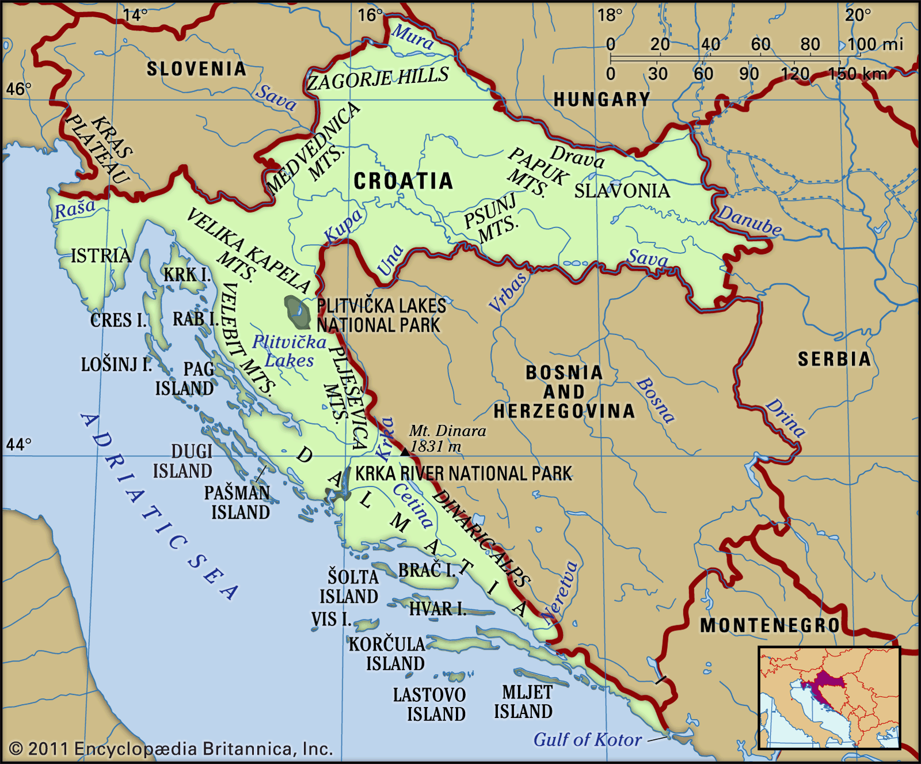
Croatia borders with Slovenia, Hungary, Serbia, Bosnia and Herzegovina, Montenegro and has a sea border with Italy.
The official language is Croatian.
Croatia is a member of: the European Union, NATO, the United Nations, the Council of Europe, the World Trade Organization and one of the founders of the Union for the Mediterranean

Slide 4
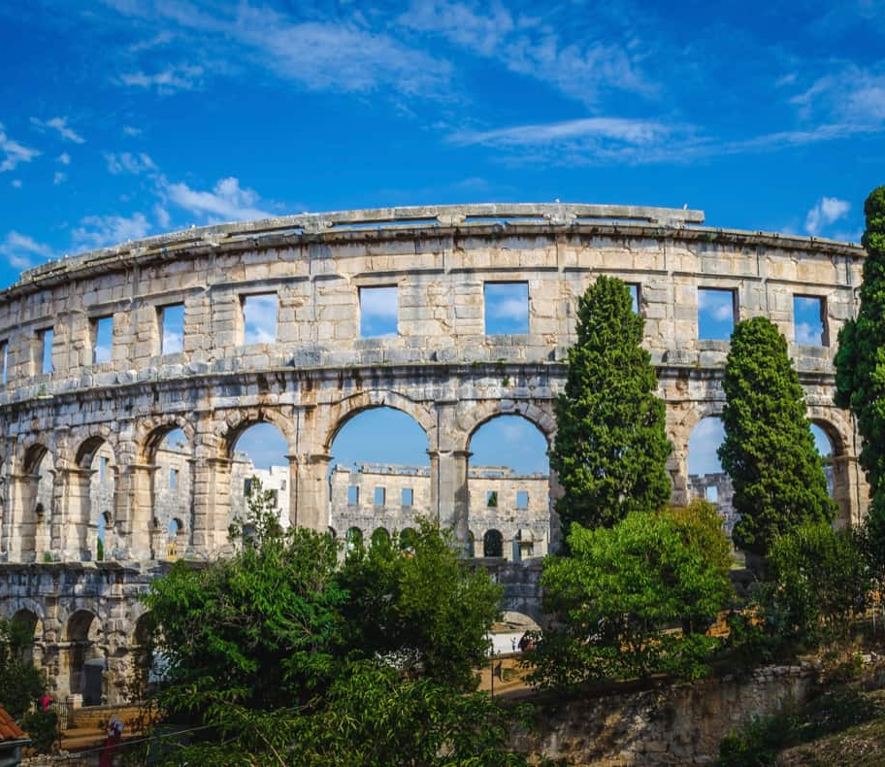
THE HISTORY OF CROATIA
Croats came at the end of the 6th century. By the 9th century, they organized the territory into two duchies
Croatia was first internationally recognized as independent on June 7th, in 879, during the reign of Prince Branimir
The first Croatian king was Tomislav

Slide 5
Varaždin

Slide 6
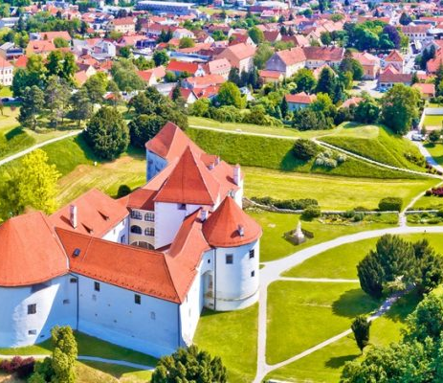
VARAŽDIN
the City of Angels,
colourful and magical events; the most famous are Špancirfest and classical music festival Baroque Evenings which celebrate music, baroque architectural inheritance and authentic instruments
Varaždin is the city of baroque
Varaždin is located in the nortwestern Croatia along the banks of the river Drava

Slide 7
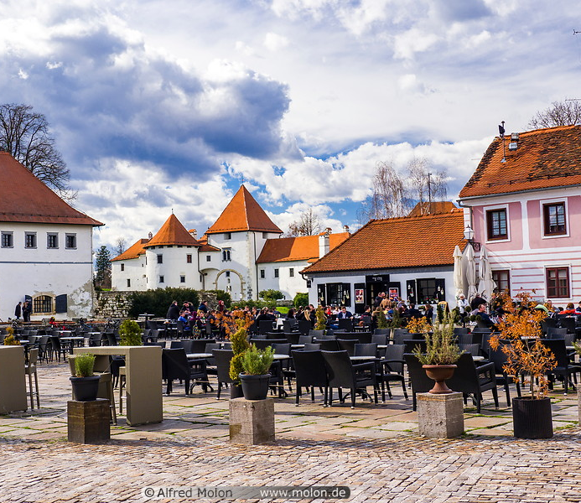
THE HISTORY OF VARAŽDIN
Varaždin became the capital city in 1756.
On the 25th April in 1776 the big fire destroyed almost 80% of all buildings and houses in Varaždin, so the administration moves back to Zagreb
The story behind the fire is about a boy, whose tobacco burned the hay and the fire soon spread outside the city walls.
The fire harried for three days and demolished the town

Slide 8
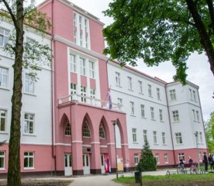
II.PRIMARY SCHOOL VARAŽDIN
In 1968 the school was declared thebest school in the country
The number of students in our school is 689
The principal of the school is Mrs. Sanja Posavec

Slide 9
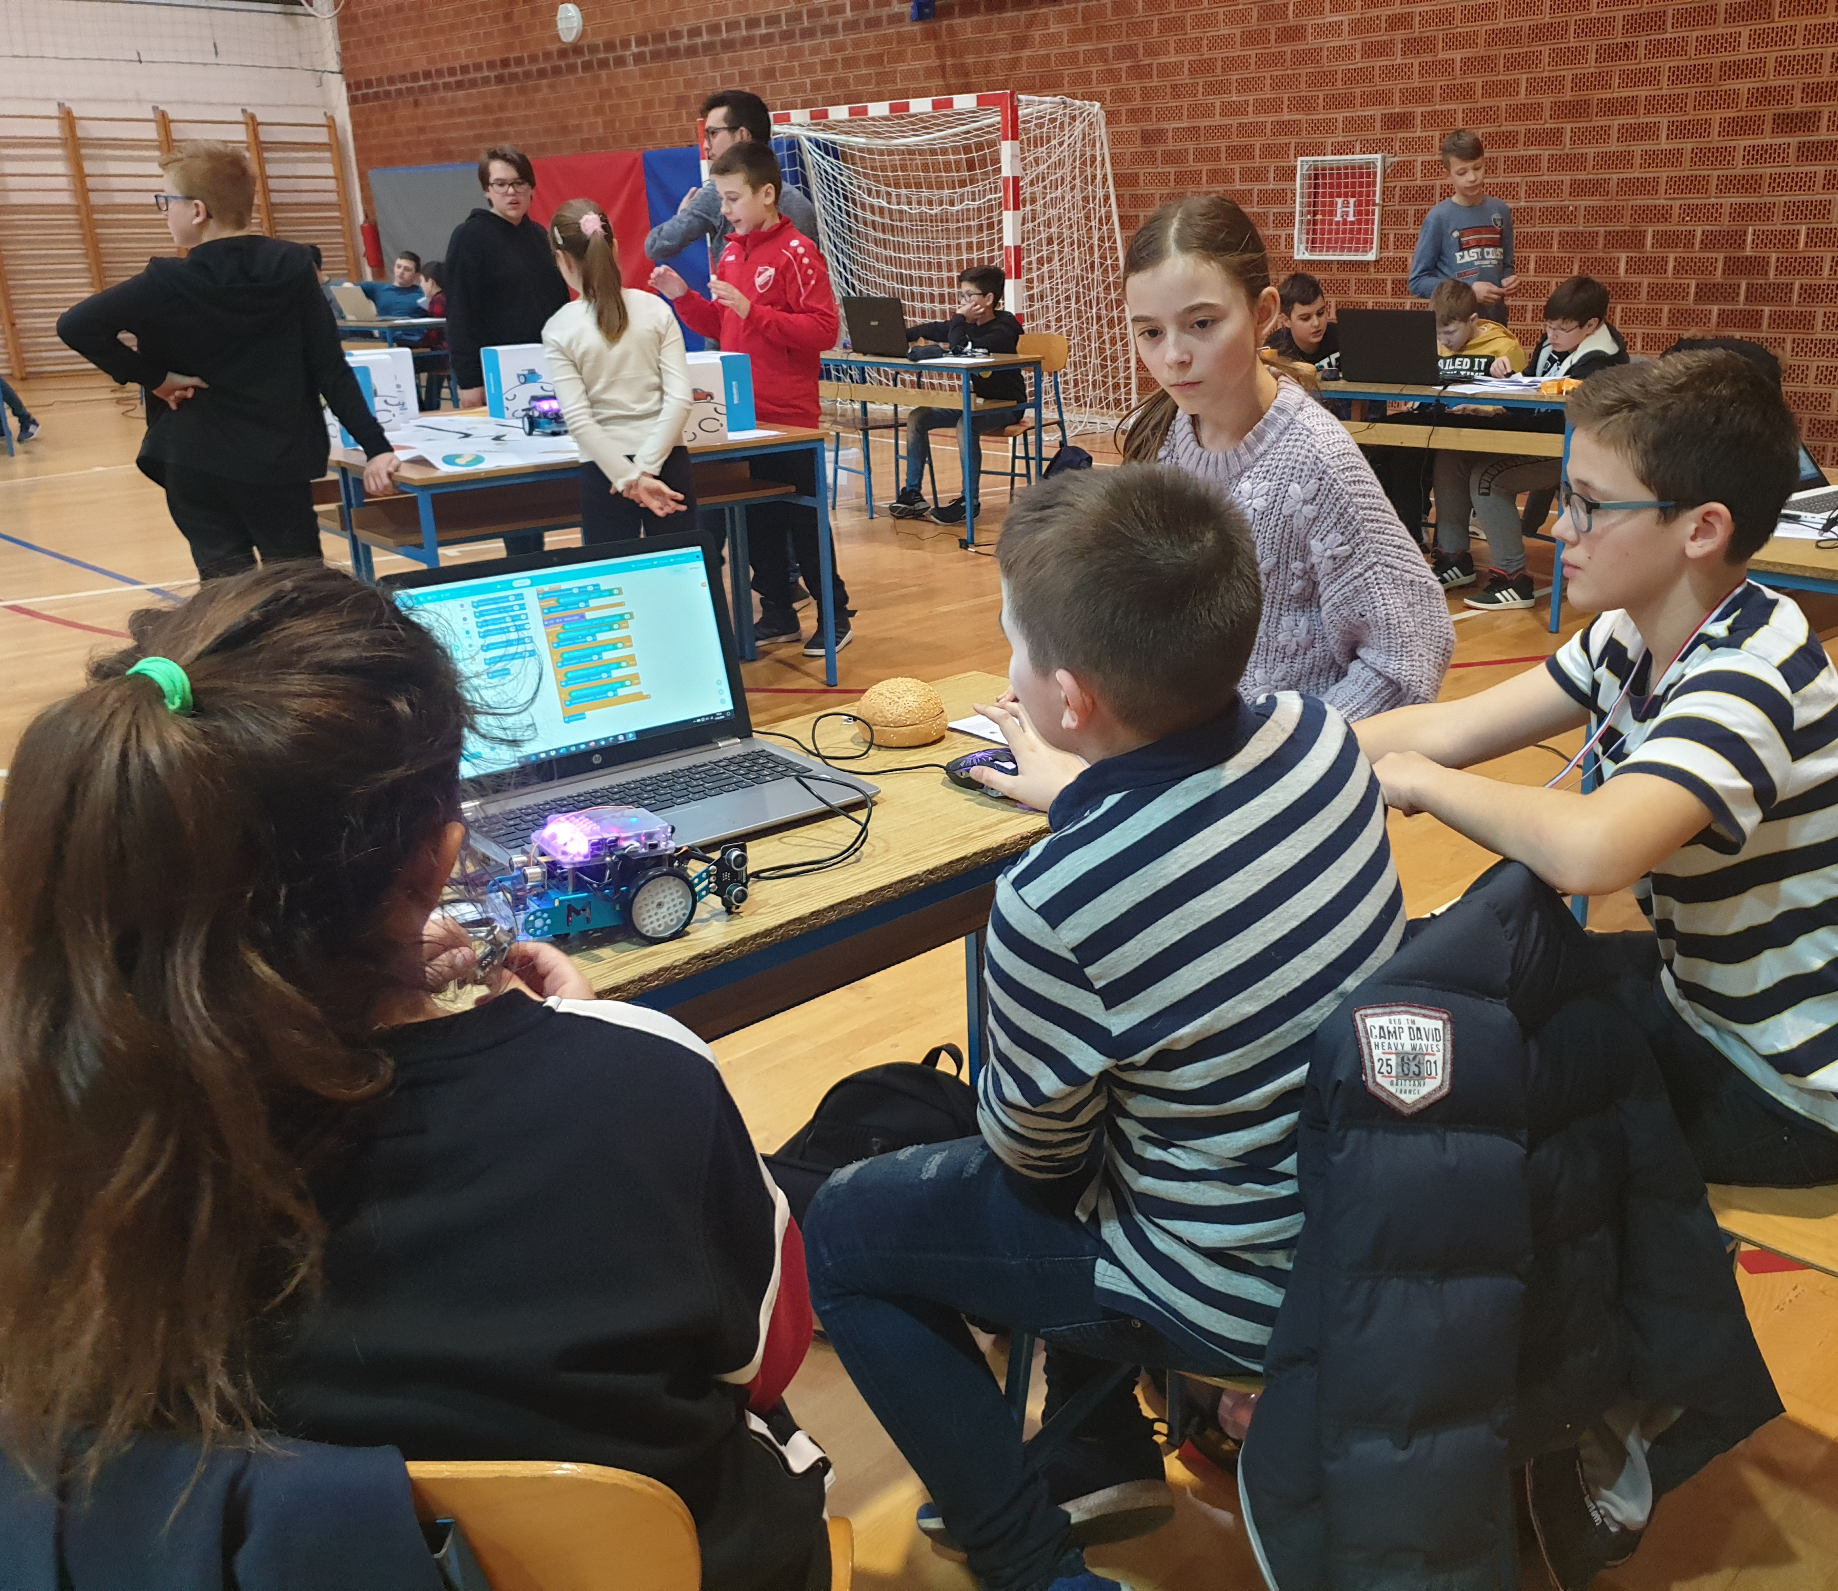
ABOUT OUR SCHOOL
Our school participates in many projects.
It participates in:
School without violence
eTwinning project
Erasmus projects

Slide 10
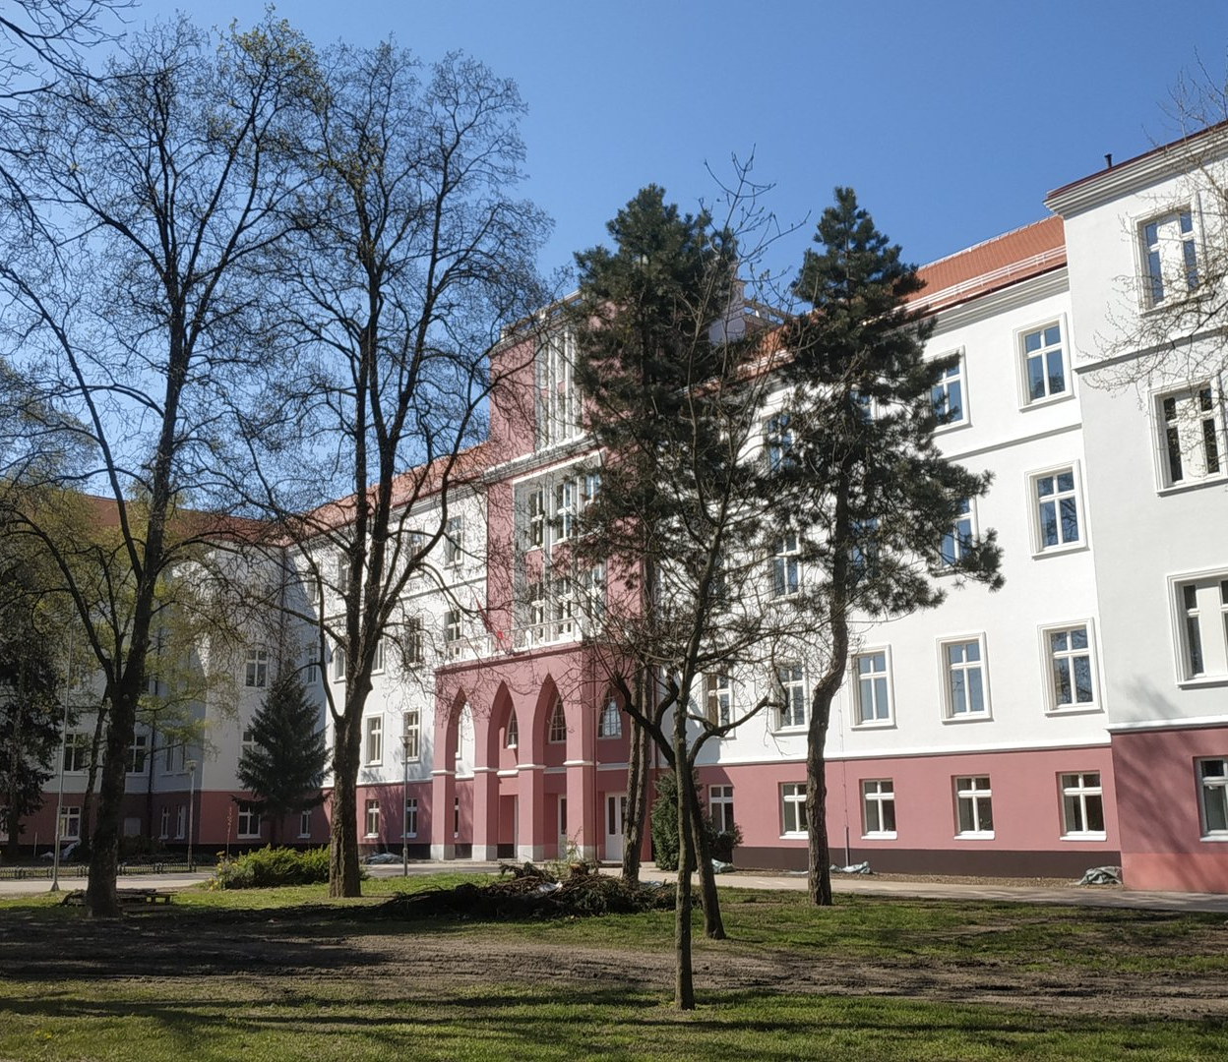
HISTORY OF II. PRIMARY SCHOOL VARAŽDIN
The school was built in 1932,and before the school there was a Franciscan gymnasium and barrocks
The school started as the second seven year school in Varaždin
From 1953 to 1990,the school operated under name Ratimir Herceg Primary School, and from 1990,the school was named II.Primary School Varaždin

Slide 11
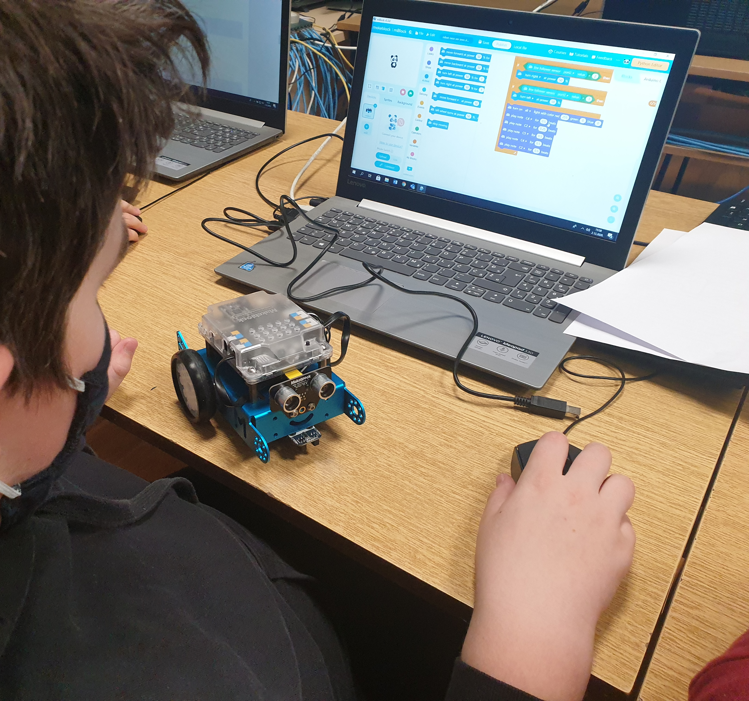
ROBOTICS
In our school we participatein project Croatian MakerSpace that is part of European MakerSpace Network
We use mBots

