Slide 1
Local services and support for people with disabilities in our town

Slide 2
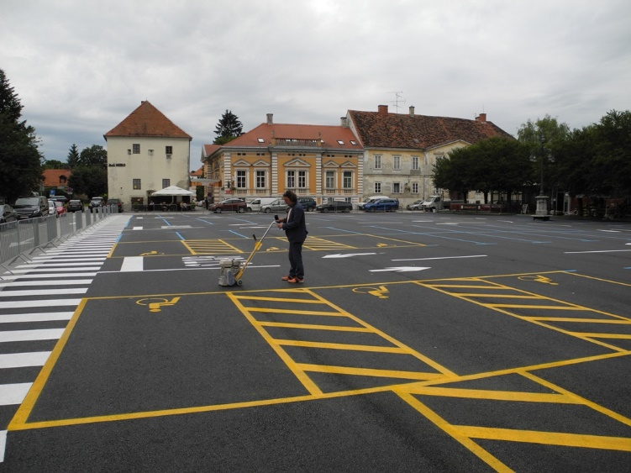
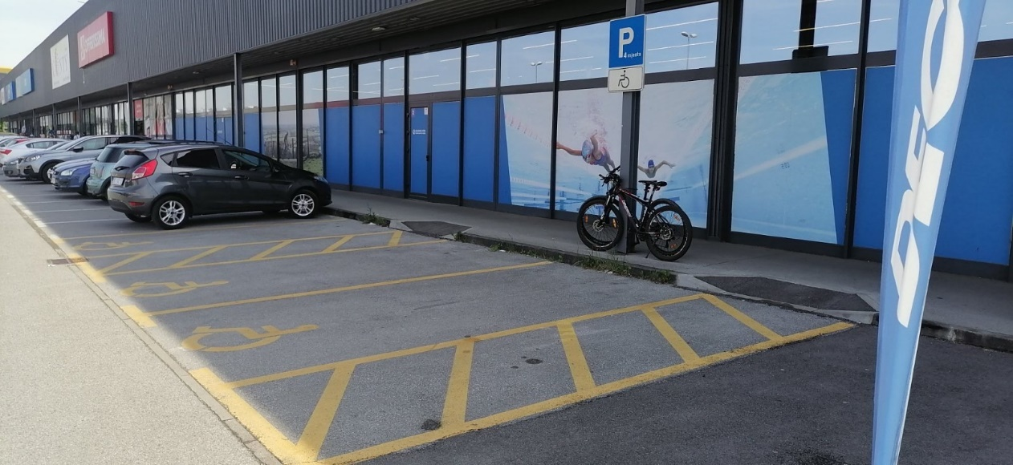
Parking slots for disabled
-closer to public institutions, stores and other services
-wider and yellow marked

Slide 3
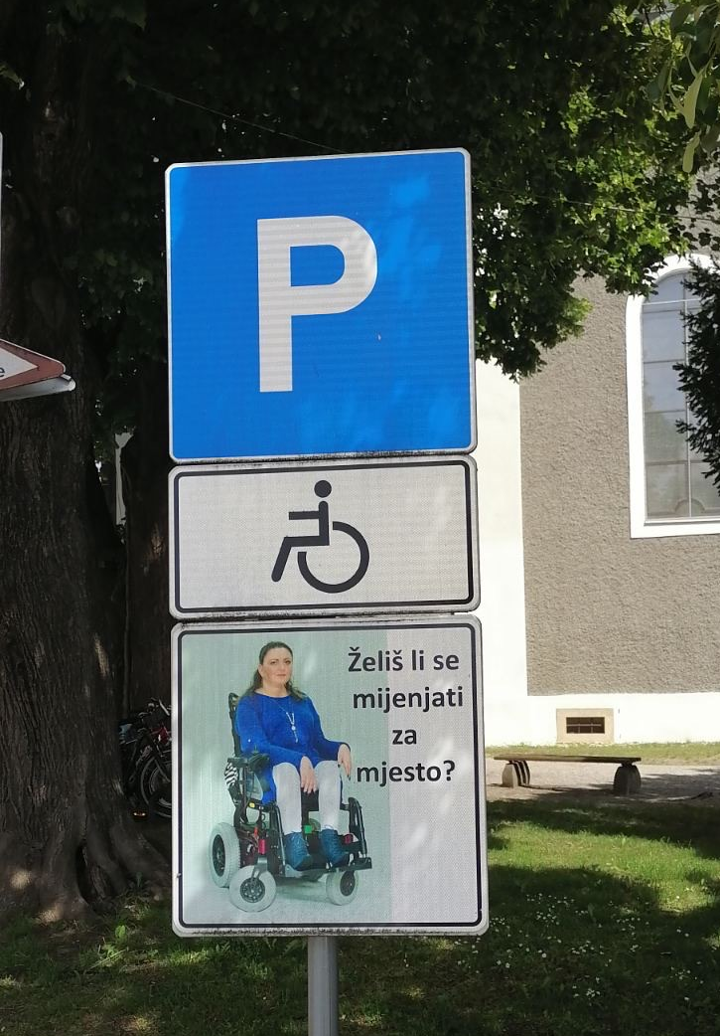
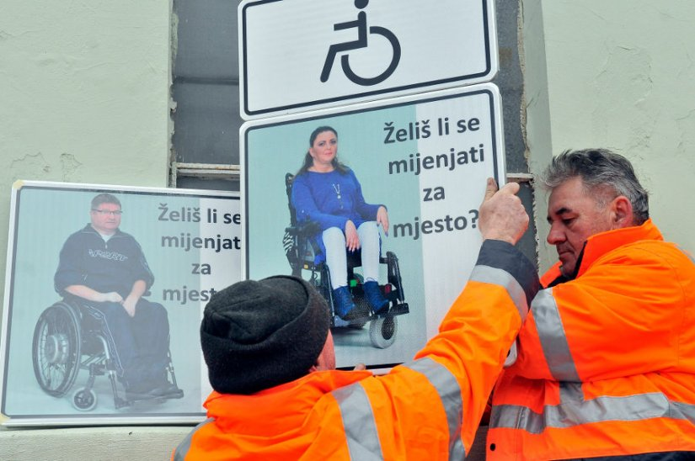
Traffic signs
-preventing others using parking slots for disabled
Translation: „Do you want to change places?”

Slide 4
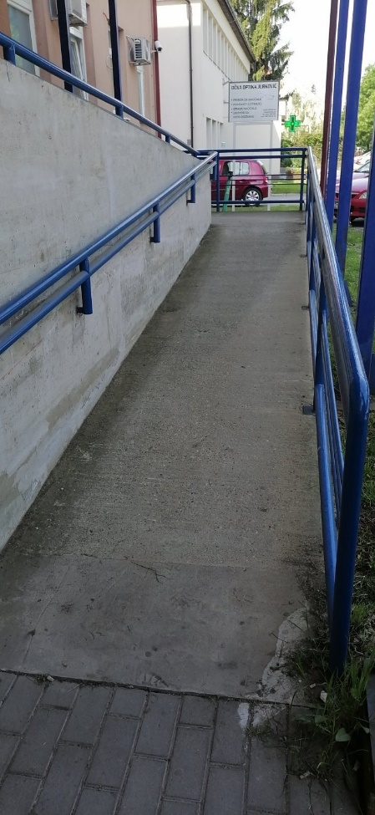
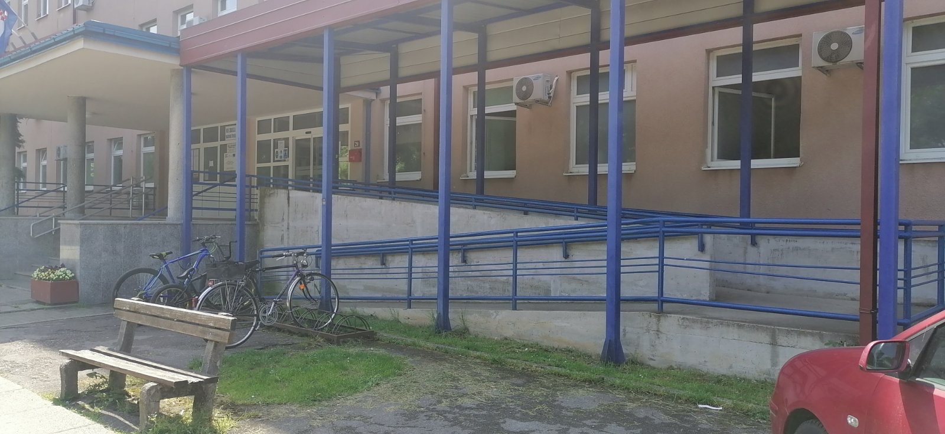
Wheelchair ramps
-at the entrance of most public institutions and stores
-they help disabled people to get acces to public services

Slide 5
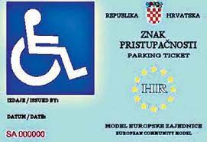
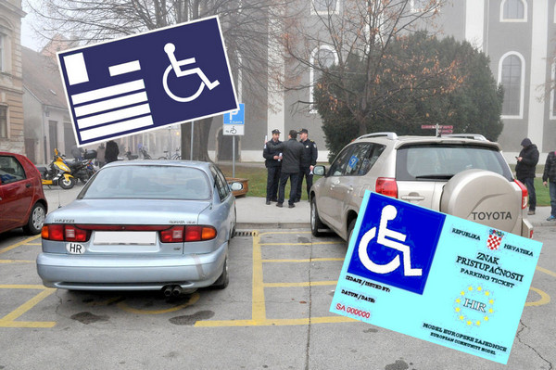
Parking ticket
-every disabled person can get a free parking ticket
-they do not have to pay for parking

Slide 6
Priority using public services
-first served
-they do not have to wait in long lines
translation: „people with disability have priority”

Slide 7
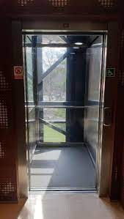
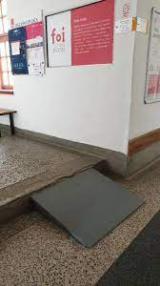
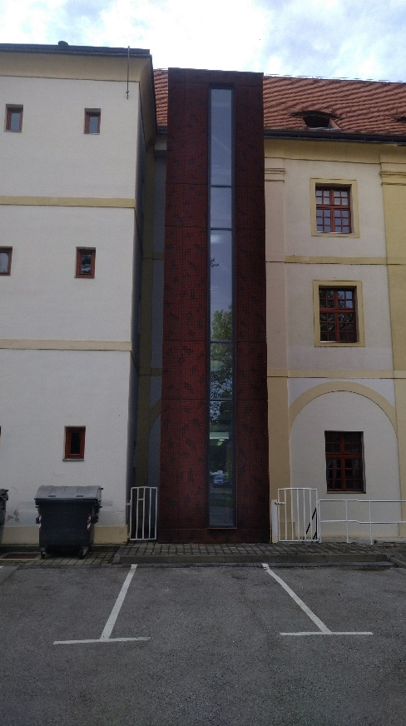
Schools and universities
-some primary schools, high schools and all universities have adapted access for people with disabilities

Slide 8
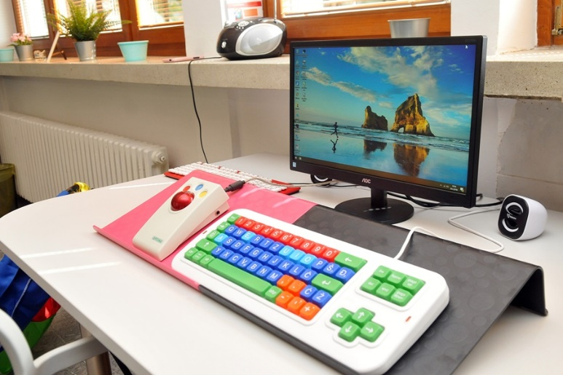
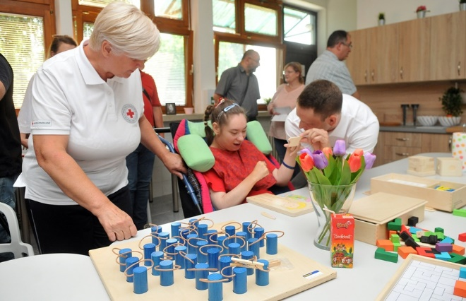
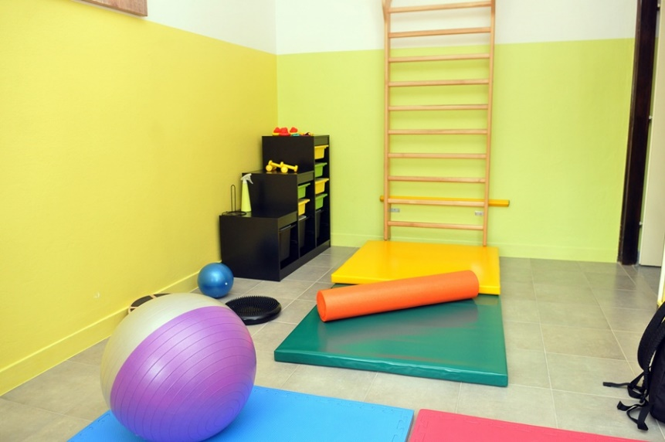
Varaždin Community Service Center
-was established with the aim of providing services to children with disabilities, young adults and adults with physical disabilities, with intellectual, sensory or mental disabilities

Slide 9
Thank you for listening!

